Slide 1
Meeting Week 12
Last week summary
LPV-LFR
Augmentation simulation
  Parameter recovery
  Additional state
Outline ToDo next week

Slide 2
Last week summary
Simulation – Parameter recovery
Trajectory
Stratified random sampling
Batching
Gradient

Slide 3
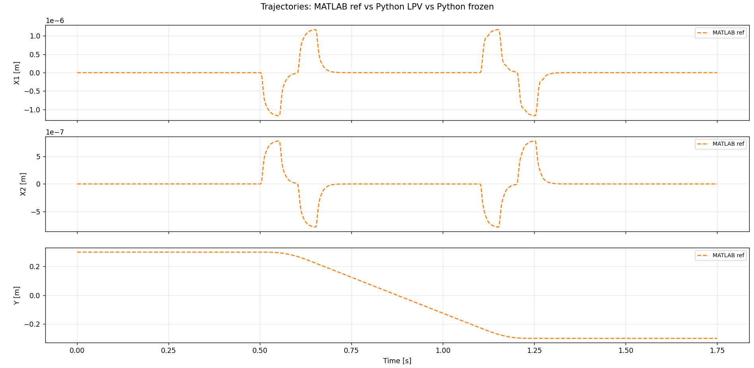
Trajectory

Slide 4
Stratified random sampling
Problem: total trajectory is too long (35001 steps) to train in one pass → solution: split it into segments (8 × 4000 per epoch)
  Divided into 4375 × 8 separate parts, but per epoch only 4000
    This allows to have different starting positions, don’t see the same segment every epoch
Stratified guarantees every part of the trajectory is seen every epoch over pure random

Slide 5
Batching
Multiple shooting
  Batch: each epoch processes all n=8 segments simulated in parallel
Each segment starts from a precomputed state (position + velocity from data)
  Positions are taken directly from q1 (measured). Velocities are not measured they are computed via central differences

Slide 6
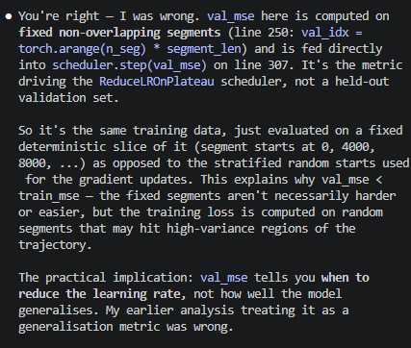
Gradient
Gradient computation
  Loss = MSE(predicted positions, measured positions)
  All 8 segments contribute, averaged before parameter updating
Adam optimizer
  Adam optimizes over the 13 parameters in log space (to guarantee M(Y) is invertible because all parameters > 0 )
Notes:
Gradient Computation
simulate() rolls out RK4 over each segment with bptt_mode='full' — full backpropagation
through time (BPTT) through all segment_len steps. The gradient flows through simulate →
_build_matrices → _recover_params → log_params (the single trainable nn.Parameter).
Gradient flows back through the RK4 simulation (full BPTT over 4000 steps per segment)
to log_params
Looks at MSE but also looks at how the develops over multiple…
Val for tuning learning rate… -->> stratisfied sampling balab

Slide 7
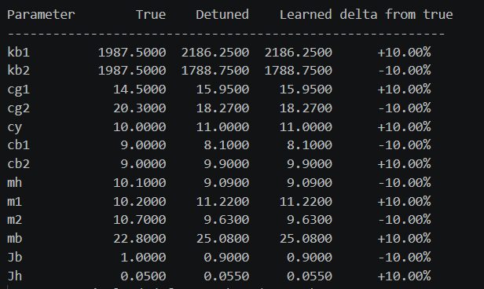
Parameter detuning
Detuned all parameters with 10 percent

Slide 8
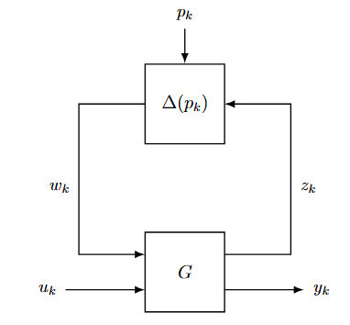
LPV-LFR - Previous
Collapsed the separate block structure with constant G matrix and varying delta block

Slide 9
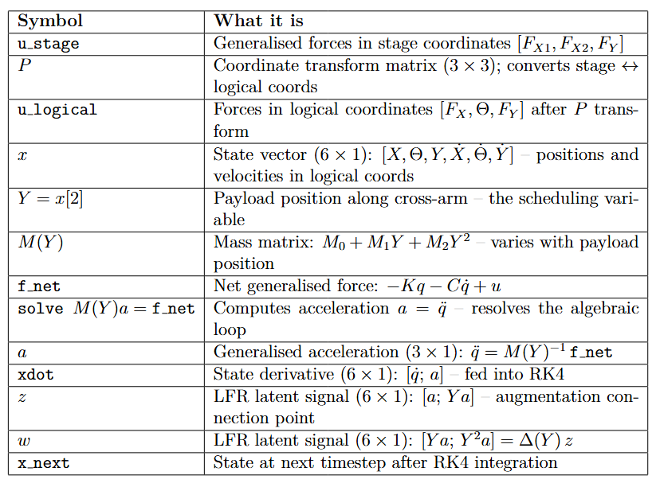
u_stage
P transform
u_transformed
X, Y, Physical parameters
lfr_forward
Solve a = M(Y)^-1 f_net
← M(Y) = M0 + M1 Y + M2 Y^2
Y = x[2] (self-scheduling)
Xdot
z
w
← z, w retained
X0 = [0, 0, 0.3, 0, 0, 0]
[x 4 RK4 sub-steps]
X_next
Notes:
Our model is CT LPV-LFR use RK4 to discretize it
The forward solves the “algebraic loop”
Calculate 4 different x states, determine x_next based on that / discretization method

Slide 10
u_stage
P transform
u_transformed
X, Y, Physical parameters
lfr_forward
Solve a = M(Y)^-1 f_net
← M(Y) = M0 + M1 Y + M2 Y^2
Y = x[2] (self-scheduling)
Xdot
z
w
← z, w retained
X0 = [0, 0, 0.3, 0, 0, 0]
[x 4 RK4 sub-steps]
X_next
Notes:
Our model is CT LPV-LFR use RK4 to discretize it
The forward solves the “algebraic loop”
Calculate 4 different x states, determine x_next based on that / discretization method

Slide 11
u_stage
P transform
u_transformed
X, Y, Physical parameters
lfr_forward
Solve a = M(Y)^-1 f_net
← M(Y) = M0 + M1 Y + M2 Y^2
Y = x[2] (self-scheduling)
Xdot
z
w
← z, w retained
X0 = [0, 0, 0.3, 0, 0, 0]
[x 4 RK4 sub-steps]
X_next
Notes:
Our model is CT LPV-LFR use RK4 to discretize it
The forward solves the “algebraic loop”
Calculate 4 different x states, determine x_next based on that / discretization method

Slide 12
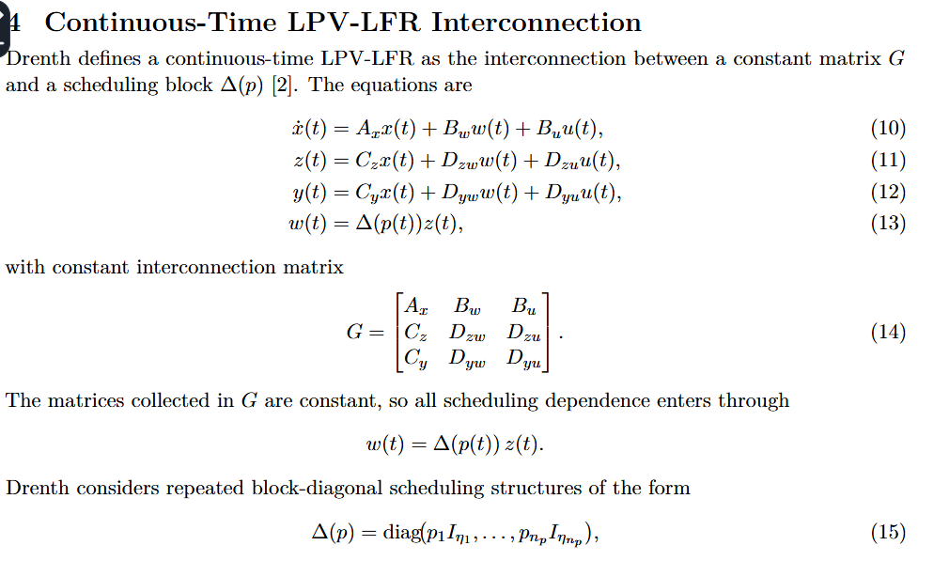
LPV-LFR

Slide 13

Solution
Inverting the I-Dzw*delta(Y)

Slide 14
Solution
Inverting the I-Dzw*delta(Y)
Now z and w can be expressed
  And now can construct constant G block and scheduling delta block

Slide 16
Simulation - Multiple Trajectories
I use the force inputs, how do I use this for specific trajectories?
I only use the initial Y position
Notes:
Grouping logic:
- T1 + T6 pair: Same Y displacement, very different dynamics ratio — needed to separate friction (cy) from inertia (mh).
- T2 + T3 pair: Same X motion, different Y position — needed to isolate mh from total translational mass.
- T4 is the only trajectory exciting the joint stiffness kb1+kb2 (via differential X motion creating cross-arm rotation).
- T5 provides a continuous sweep of the scheduling variable Y(t), giving the full M1 coupling range in one shot.

Slide 17
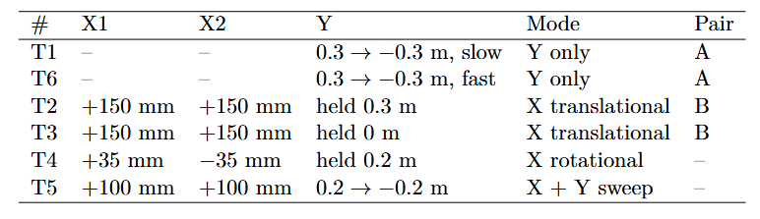
Simulation
Multiple Trajectories
Notes:
How theta is defined, difference
Max formula was 72 mm

Slide 18
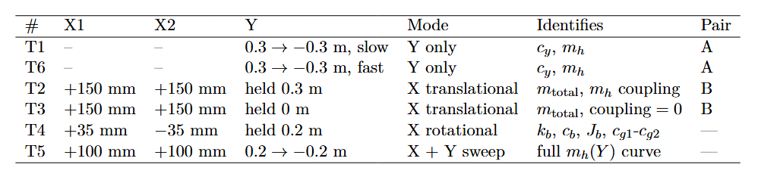
Simulation
Multiple Trajectories
Notes:
How theta is defined, difference
Max formula was 72 mm

Slide 19
Simulation
Multiple Trajectories

Slide 20
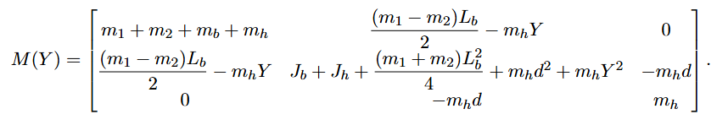

Slide 24
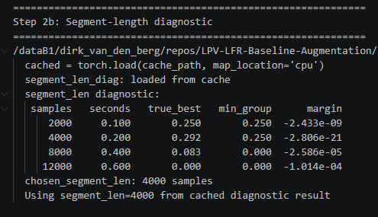
Simulation
Diagnosis segment length

Slide 25
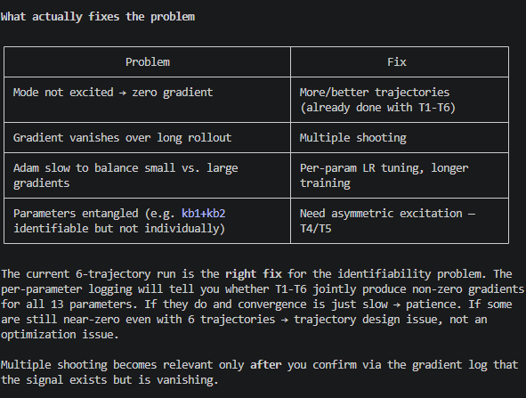

Slide 26
Simulation
Channel normalization
Sigma: per-channel std of X1, X2, Y pooled over all 6 trajectories
Loss: MSE((q1_sim − q1_meas) / σ), normalizing X1, X2, Y to equal weight
(q1 is the measured stage positions)

Slide 27
Simulation - Result

Slide 28
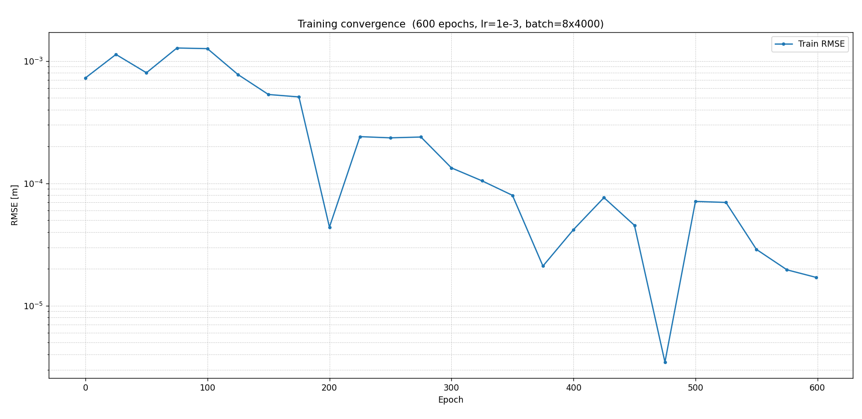

Slide 29
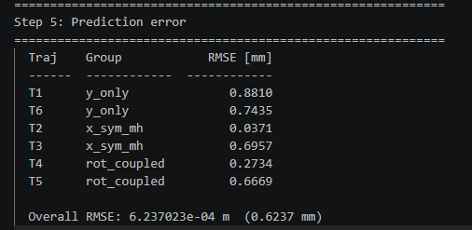

Slide 30
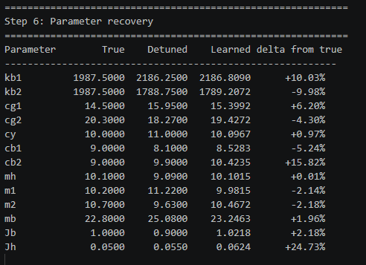
Notes:
Overal result is worse, but parameter recovery overall is better. But that’s mainly due to before one trajectory
Don’t clearly show per channel (X1, X2, and Y) currently

Slide 31
Simulation - Conclusion
Parameter recovery improved: earlier only Y-sweep didn’t “expose” all the parameters
Overal RMSE is worse and not yet in acceptable range
  Worse compared to single trajectory, but not fair comparison due to overfitting
(Don’t clearly show per channel (X1, X2, and Y) currently)

Slide 32
Feedback not processed
Multishoot for parameters currently not implemented

Slide 33
Augmentation – Additional state
Requirements
Suggestion
Implementation

Slide 34
Requirements
New state should not be measured directly.
Structurally non-absorbable by the rigid baseline
The effect of the added state must be visible enough in the measured signals for the augmentation to detect it
Physically interpretable
Notes:
Hidden from the output
(if I plant o add noise SNR: compare hidden-state contribution to noise
map:

Slide 35
Requirements
New state should not be measured directly.
  Indirect visible through dynamics: We only see the effect of it / it disturbs the measured motion
Structurally non-absorbable by the rigid baseline (hard to quantify)
  The original baseline model can’t fake the effect by changing its parameter values → the baseline would need to add states to imitate it
The effect of the added state must be visible enough in the measured signals for the augmentation to detect it
  Could be quantified before implementing augmentation:
    Relative output contribution compared to total measured motion
    Residual of best re-identified model after refitting the baseline parameters on data
Physically interpretable
  Relevant to the gantry
Notes:
Hidden from the output
(if I plant o add noise SNR: compare hidden-state contribution to noise
map:

Slide 36
Suggestion
Additional Mass Spring Damper attached to payload mass (mh)
  Position and velocity as additional states
  Similar to Jan adding MSD
  I can justify it with a sensor or camera

Slide 37

Comparison with Jan

Slide 38
Comparison with Jan
With p3 the position of the additional mass - not measured

Slide 39


Slide 41
Note:
Picture is not fully accurate, we define the mass as the relative displacement from mh currently
Will need to add offset

Slide 42

Lagrange-Euler - Garcia

Slide 43

Lagrange-Euler - Garcia

Slide 44
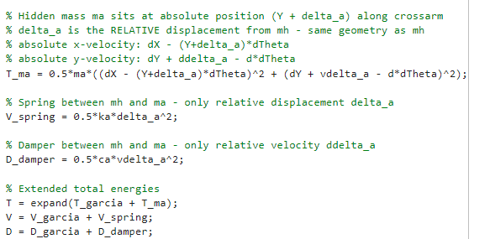
Lagrange-Euler – Additional state
Notes:
Why $T_{ma}$Has No $J_{a}$Term
$m_{a}$is modeled as a point mass — it has no rotational inertia about its own center of mass.
Linear spring: linear spring potential energy
Jan also has linear spring…?

Slide 45
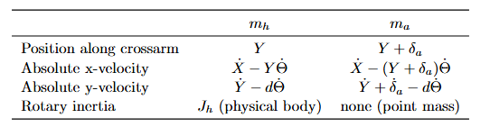
Lagrange-Euler – Additional state
Notes:
Why $T_{ma}$Has No $J_{a}$Term
$m_{a}$is modeled as a point mass — it has no rotational inertia about its own center of mass.
Linear spring: linear spring potential energy
Jan also has linear spring…?

Slide 46
Lagrange-Euler – Additional state
Notes:
Why $T_{ma}$Has No $J_{a}$Term
$m_{a}$is modeled as a point mass — it has no rotational inertia about its own center of mass.
Linear spring: linear spring potential energy
Jan also has linear spring…?

Slide 47
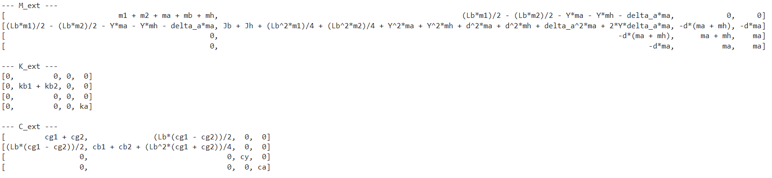
Symbolic toolbox result
4th row and 4th column is the addition of the additional state delta_a

Slide 48
Additional state – To do
Verify with simscape model
Add offset

Slide 49
Question 1
Possible to get additional information for gantry system

Slide 50
Outline next week
Validate additional state with simscape
Simulation ensure proper identification for parameter recovery
Add multisine for identification to the trajectories

Slide 51
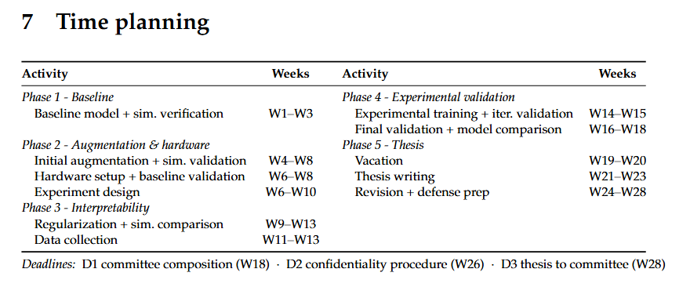
Planning – Week 4

Slide 52
Planning – Week 4

Slide 53
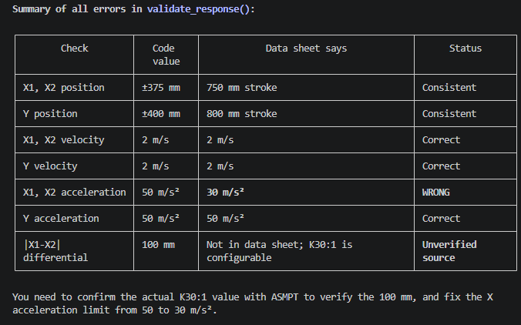
Trajectories limits

Slide 54
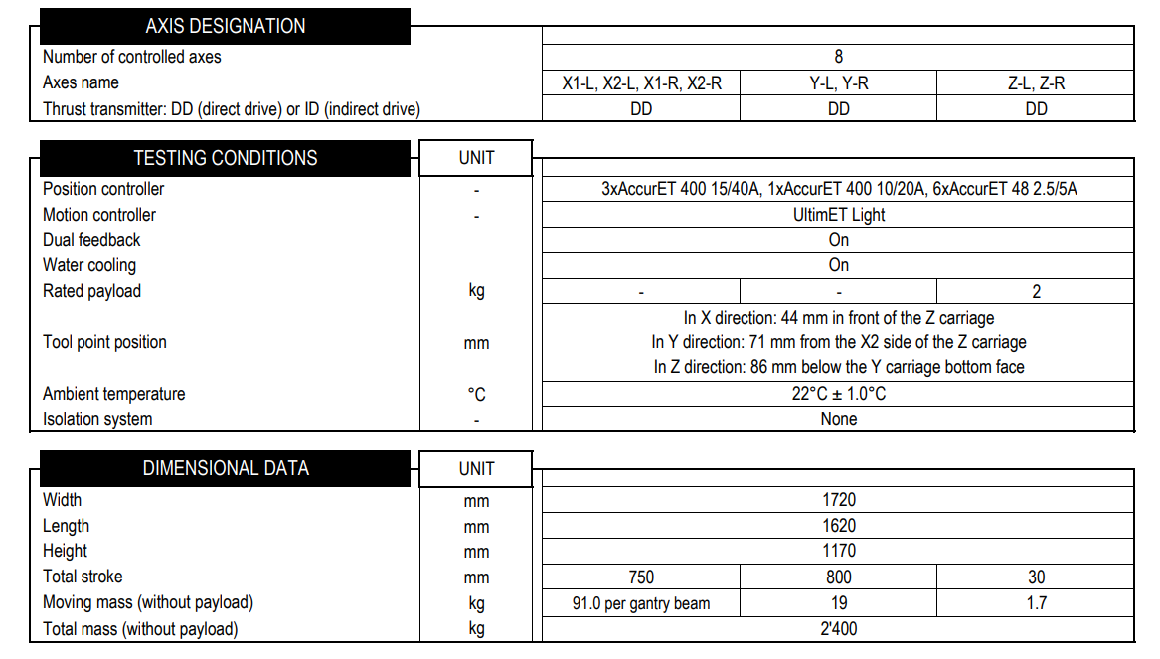

Slide 56
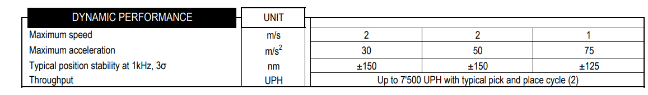

Slide 57
Filter unrealistic profiles
validate_response(q1, fs) checks the actual response against all ETEL limits (position,
velocity, per-axis acceleration, yaw differential)
4. If it passes: record amp_max = amp, try the next higher amplitude
5. If it fails: stop the sweep, amp_max holds the last passing value
6. Run one final simulation at amp_max to get the clean training data

Slide 58
